Slide 1


STUDENT CLUB AND ORGANIZATION FUNDING OVERVIEW

Slide 2
Student Activity Fee
SGA oversees the Student Activity Budget, comprised of $691,318.33 from collected by the Student Activity Fee, paid by each student on their tuition statements.
Clubs & Orgs funding consists of $170,000.00 allocated from the Student Activity Budget for all student clubs & orgs on campus.
  BAC funding is limited to $4000 per student club/organization per academic year (excluding ROAR Days funding)
BAC is in charge of creating the Student Activity Budget, which gets approved by Senate after BAC deliberation and approval during Budget Season (Spring semester).

Slide 3
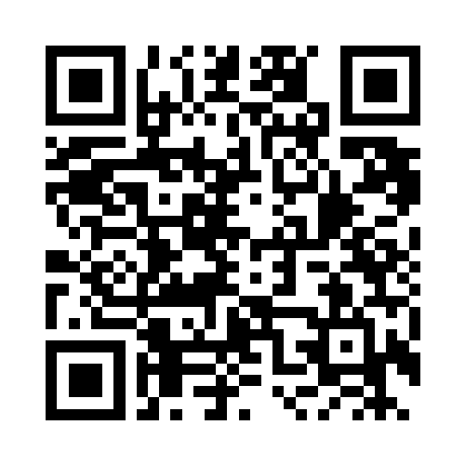
Funding Proposal Timeline
Funding proposals are due at least 2 weeks prior to planned event or travel*
SCAN FOR FUNDING PROPOSAL
  Must have registered MLC event prior to Funding Proposal submission for event funding
  Must have submitted a Intent to Travel form prior to Funding Proposal submission for travel funding
Funding proposals are per event/travel. Recurrent similar events may be grouped into a singular proposal.
mlc.uccs.edu
*proposals with less notice are subject to the discretion of the SGA Director of Finance

Slide 4
Proposal Information
Two points of contact required for each proposal
  Primary contact must use their UCCS email
  Ensure all contact information is inputted correctly
Funding Category must fall under Event or Travel (or ROAR Days)*
  Conference registration costs are considered Event costs, however they should be included in the same form as any associated Travel expenses
Date of anticipated expenses should be at least one week prior to Event or Travel date to allow ample time for purchasing
*ROAR Days proposals are only considered for approved ROAR Days events. That occurs during the scheduled ROAR Days funding hearing, in the spring semester.

Slide 5
Travel Information
Travel expenses follow the below guidance. Exceptions are at the discretion of the SGA Director of Finance.
  < 6hrs driven from UCCS campus to destination = two ground transportation quotes
  6-10hrs driven from UCCS campus to destination = one ground transportation quote AND one airfare quote (airfare quote must be from Christopherson Business Travel)
  10+hrs driven from UCCS campus to destination = two airfare quotes (one must be from Christopherson Business Travel)
If there are any questions regarding travel arrangements, or how to create a Christopherson quote, please reach out to SGABAC@uccs.edu

Slide 6
Event Information
Durable Goods are non-consumable supplies. Non-consumable supplies retain MORE than a significant value (>$50/item) after completion of the event.
  Composite items, comprised of items which may or may not individually have a significant value, which together have a significant value are considered durable goods
  All durable goods must present an estimated lifespan of the good, as well as a plan for storage/maintenance in their funding proposal
All SGA funded advertisements must clearly display “sponsored by SGA” (and where possible utilize the official SGA typographic treatment)

Slide 7
Proposal Summary
SGA funding is limited to $4000 per student club/organization per academic year (excluding ROAR Days funding)
  No more than $3000 may be allocated to a singular expense category (travel or events)
  Funding must be spent by the anticipated expense date, or Spring Commencement, whichever is sooner
SGA funding can not be used for:
  After-the-fact funding
  Alcohol, tobacco, controlled substances, firearms purchases
  Cash equivalents (i.e., gift cards)
  Debt relief
  Payments for services by university employees

Slide 8
Proposal Justification
Towards the end of each funding proposal, writers will need to:
  Describe the intended benefit the event will bring to the campus community
  Describe how the Student Activities Fee funding will affect your ability to hold this event/travel
  Explain the educational, civic, and cultural impact the event will have on the campus and the community
If there are any questions regarding proposal justifications please reach out to SGABAC@uccs.edu

Slide 9
SGA Funding Hearing
Your proposal will be heard by the SGA Budget Advisory Committee at your scheduled hearing (occuring each Tuesday at 5pm)
  An invitation to the hearing will be sent prior to the hearing, by the SGA Director of Finance (SGABAC@uccs.edu)
  Funding defense must be done in-person
Each proposal will receive up-to 2-minutes to present to SGA Committee members
  Committee members will review your proposal prior to your hearing
  Any appointed officer defending the funding proposal must be willing to defend any questions asked by SGA committee members regarding

Slide 10
After Your Hearing
If your proposal is approved by the SGA Budget Advisory Committee, you will receive the SGA Approval Letter from SGAFUNDS@uccs.edu
This approval letter is your proof of funding!
  It is a required upload for Purchase Order Requests as well as Reimbursement Requests, via MLC
  It should be shared with Event Services and/or Catering, by the club/organization officer, if costs are related to any event service or catering charges

Slide 11
QUESTIONS?
Contact SGABAC@uccs.edu

